Slide 1
Financial analysis

Slide 2
Agenda
Business Problem
Tools Used
Understanding Problems & Solutions
Data Transformations
Key Insights
Dashboard

Slide 3
Current Flow
Business Problem
Daily receive around 25 financial data files via email at 3 PM from the distributed survey team.
Tight deadline to process and build the dashboards by 8 PM on the same day.
Downloading Files
Combining Files
Cleaning Files
Building Dashboard
Sharing Insights

Slide 4
Continue…
Challenges Faced:
Time-consuming processes affecting on-time delivery.
Increase labor cost (~$12000/Month).
Increase error rates
Resource strain impacting ongoing projects.
What Client Want?
Reduce Time
Minimize Errors during data manipulation and processing.
Reduce Costs
Reduce Workload

Slide 5







Tools Used
Outlook
Google Drive
Microsoft Power Automat
API Services
Python
Power BI Desktop
Power BI Services/ Power Fabric

Slide 6

Understanding problems & solutions
Time-saving automation strategy

Slide 7
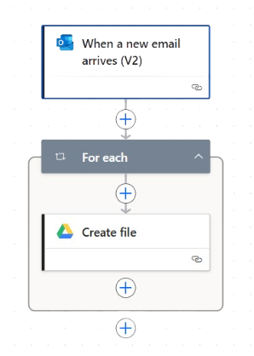
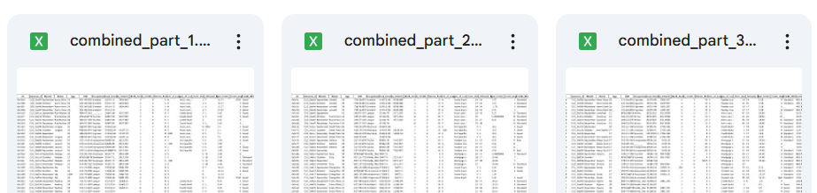
Automation Process
Email rule setup in Outlook :
If subject or body contains keywords “Credit Score”,
Move email to folder name “FA”.
Power Automate Workflow :
Trigger :
When a new mail arrives (V2) + FA folder + Includes email attachment.
Action :
Save each attachment to a specific Google Drive folder.
Fetch Data from Google Drive to Power BI :
Direct Connection from Power Desktop to Drive isn’t Possible.
Solution :
Use GCP API Key to fetch data using python

Slide 8
Data Transformation

Slide 9
Data transformation
Data transformation enhances accuracy, consistency, and performance, ensuring refined data for seamless analysis and meaningful insights.
Key Tasks Performed:
Removed Unnecessary Columns: Eliminated redundant data to improve efficiency.
Handled Missing Values: Replaced blank spaces with appropriate defaults for consistency.
Changed Data Types: Ensured compatibility by converting data formats.
Managed Outliers: Adjusted extreme values in Age and Number of Bank Accounts to enhance accuracy.
Impact: Improved data reliability, better analytical insights, and optimized processing for decision-making.
Would you like me to refine or add visuals to this content?

Slide 10
Key insights & dashboard

Slide 11
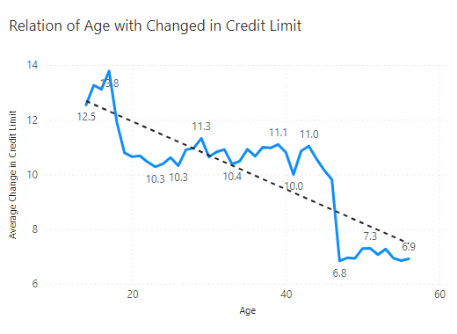
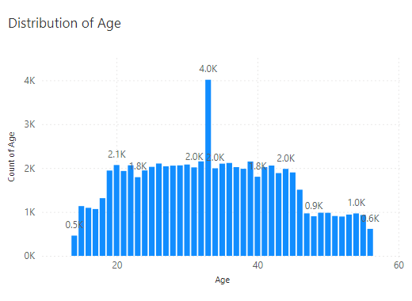
Questions & solutions
Relationship between Age and changes in credit limit :
At 13.78, 17 had the highest Average of Changed Credit Limit and was 101.38% higher than 47, which had the lowest Average of Changed Credit Limit at 6.84
Age Distribution :
At 4,013, 33 had the highest Count of Age and was 770.50% higher than 14, which had the lowest Count of Age at 461.

Slide 12
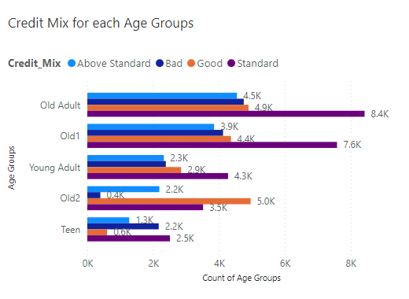
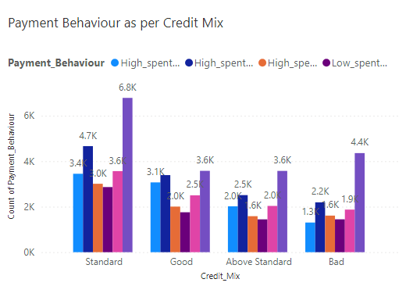
Continue…
Age Group Wise Credit Mix:
Standard had the highest total Count of Age Groups at 26,313, followed by Good, Above Standard, and Bad.
Old Adult in Credit Mix Standard made up 11.70% of Count of Age Groups.
Payment Behaviour as per Credit Mix:
Standard in Payment Behaviour Low spent Small value payments made up 10.19% of Count of Payment Behaviour.

Slide 13
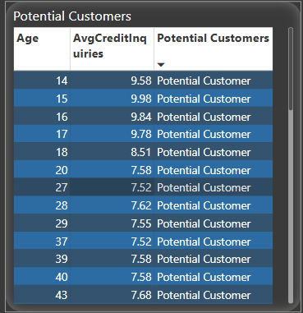
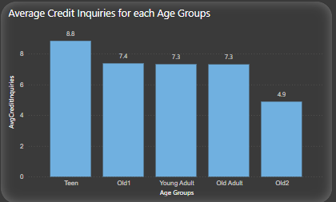
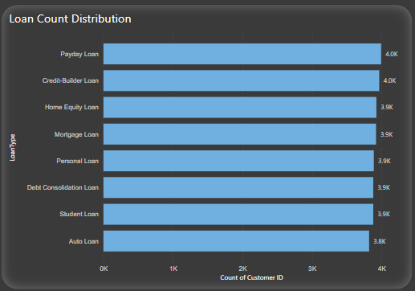
Continue…
Average Credit Inquiries & Potential Customers:
Average Credit Inquiries for each Age Group:
Loan Distribution :
Potential customers are defined as individuals whose ages correspond to an average number of credit inquiries exceeding 7.5.
At 8.84, Teen had the highest Average Credit lnquiries and was 80.96% higher than Old2, which had the lowest Average Credit lnquiries at 4.88.
Payday Loan had the highest Count of Customers at 3,993.
Auto Loan had the lowest Count of Customers at 3,820.

Slide 14
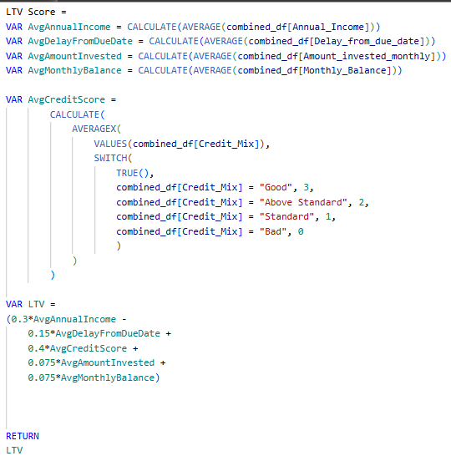
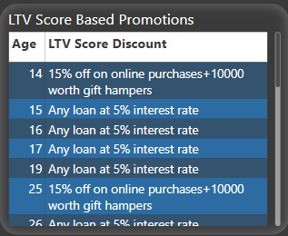
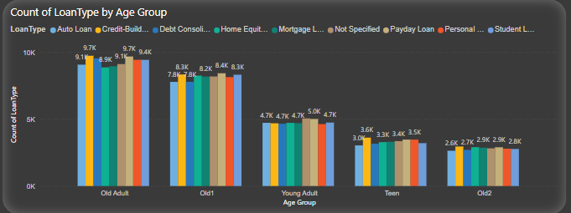
Continue…
LTV Score (LifeTime Value Score)
Cout of Loan Type of Age Group :
Older adults take out more loans than other age groups across all loan categories.

Slide 15
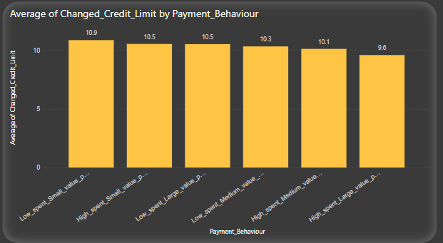
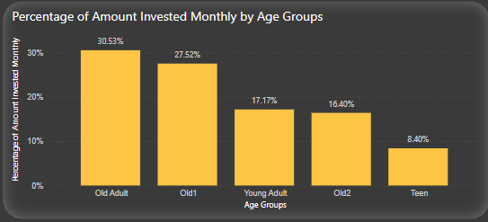
Continue…
Average change of credit limit by payment behaviour :
At 10.86, Low spend small value payments has the highest Average of changed credit limit and was higher than High spend large value payment, which had the lowest Average of changed credit limit at 9.58.
Percentage of Amount Invested Monthly by Age Groups:
At 30.53%, Old Adult had the highest Percentage of Amount Invested monthly and was 263.58% higher than Teen (8.4%).

Slide 16
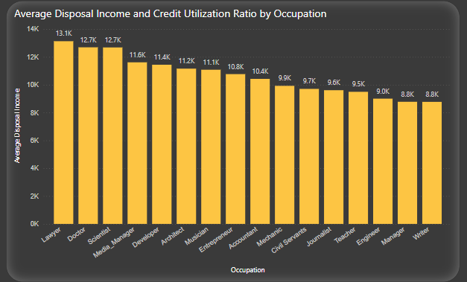
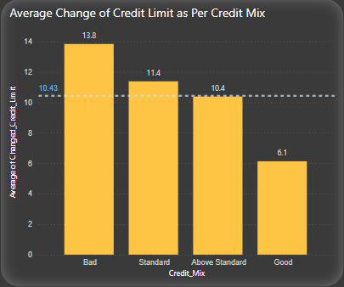
Continue…
Average Disposal Income by Occupation:
At 13130.44, Lawyer had the highest Average Disposal Income and was 49.7% highest than writer, which had the lowest Average Disposal Income at 8771.43.
Average Change as per Credit Mix:
Bad Credit Mix had the highest Average of change in credit limit at 13.8 and was 125.88% higher than Good Credit Mix.

Slide 17
Dashboard
Interactive Report
Weekly Refresh
Scheduled every Friday at 11 AM
Auto-Update Report & Dashboard
Update Alerts

Slide 18
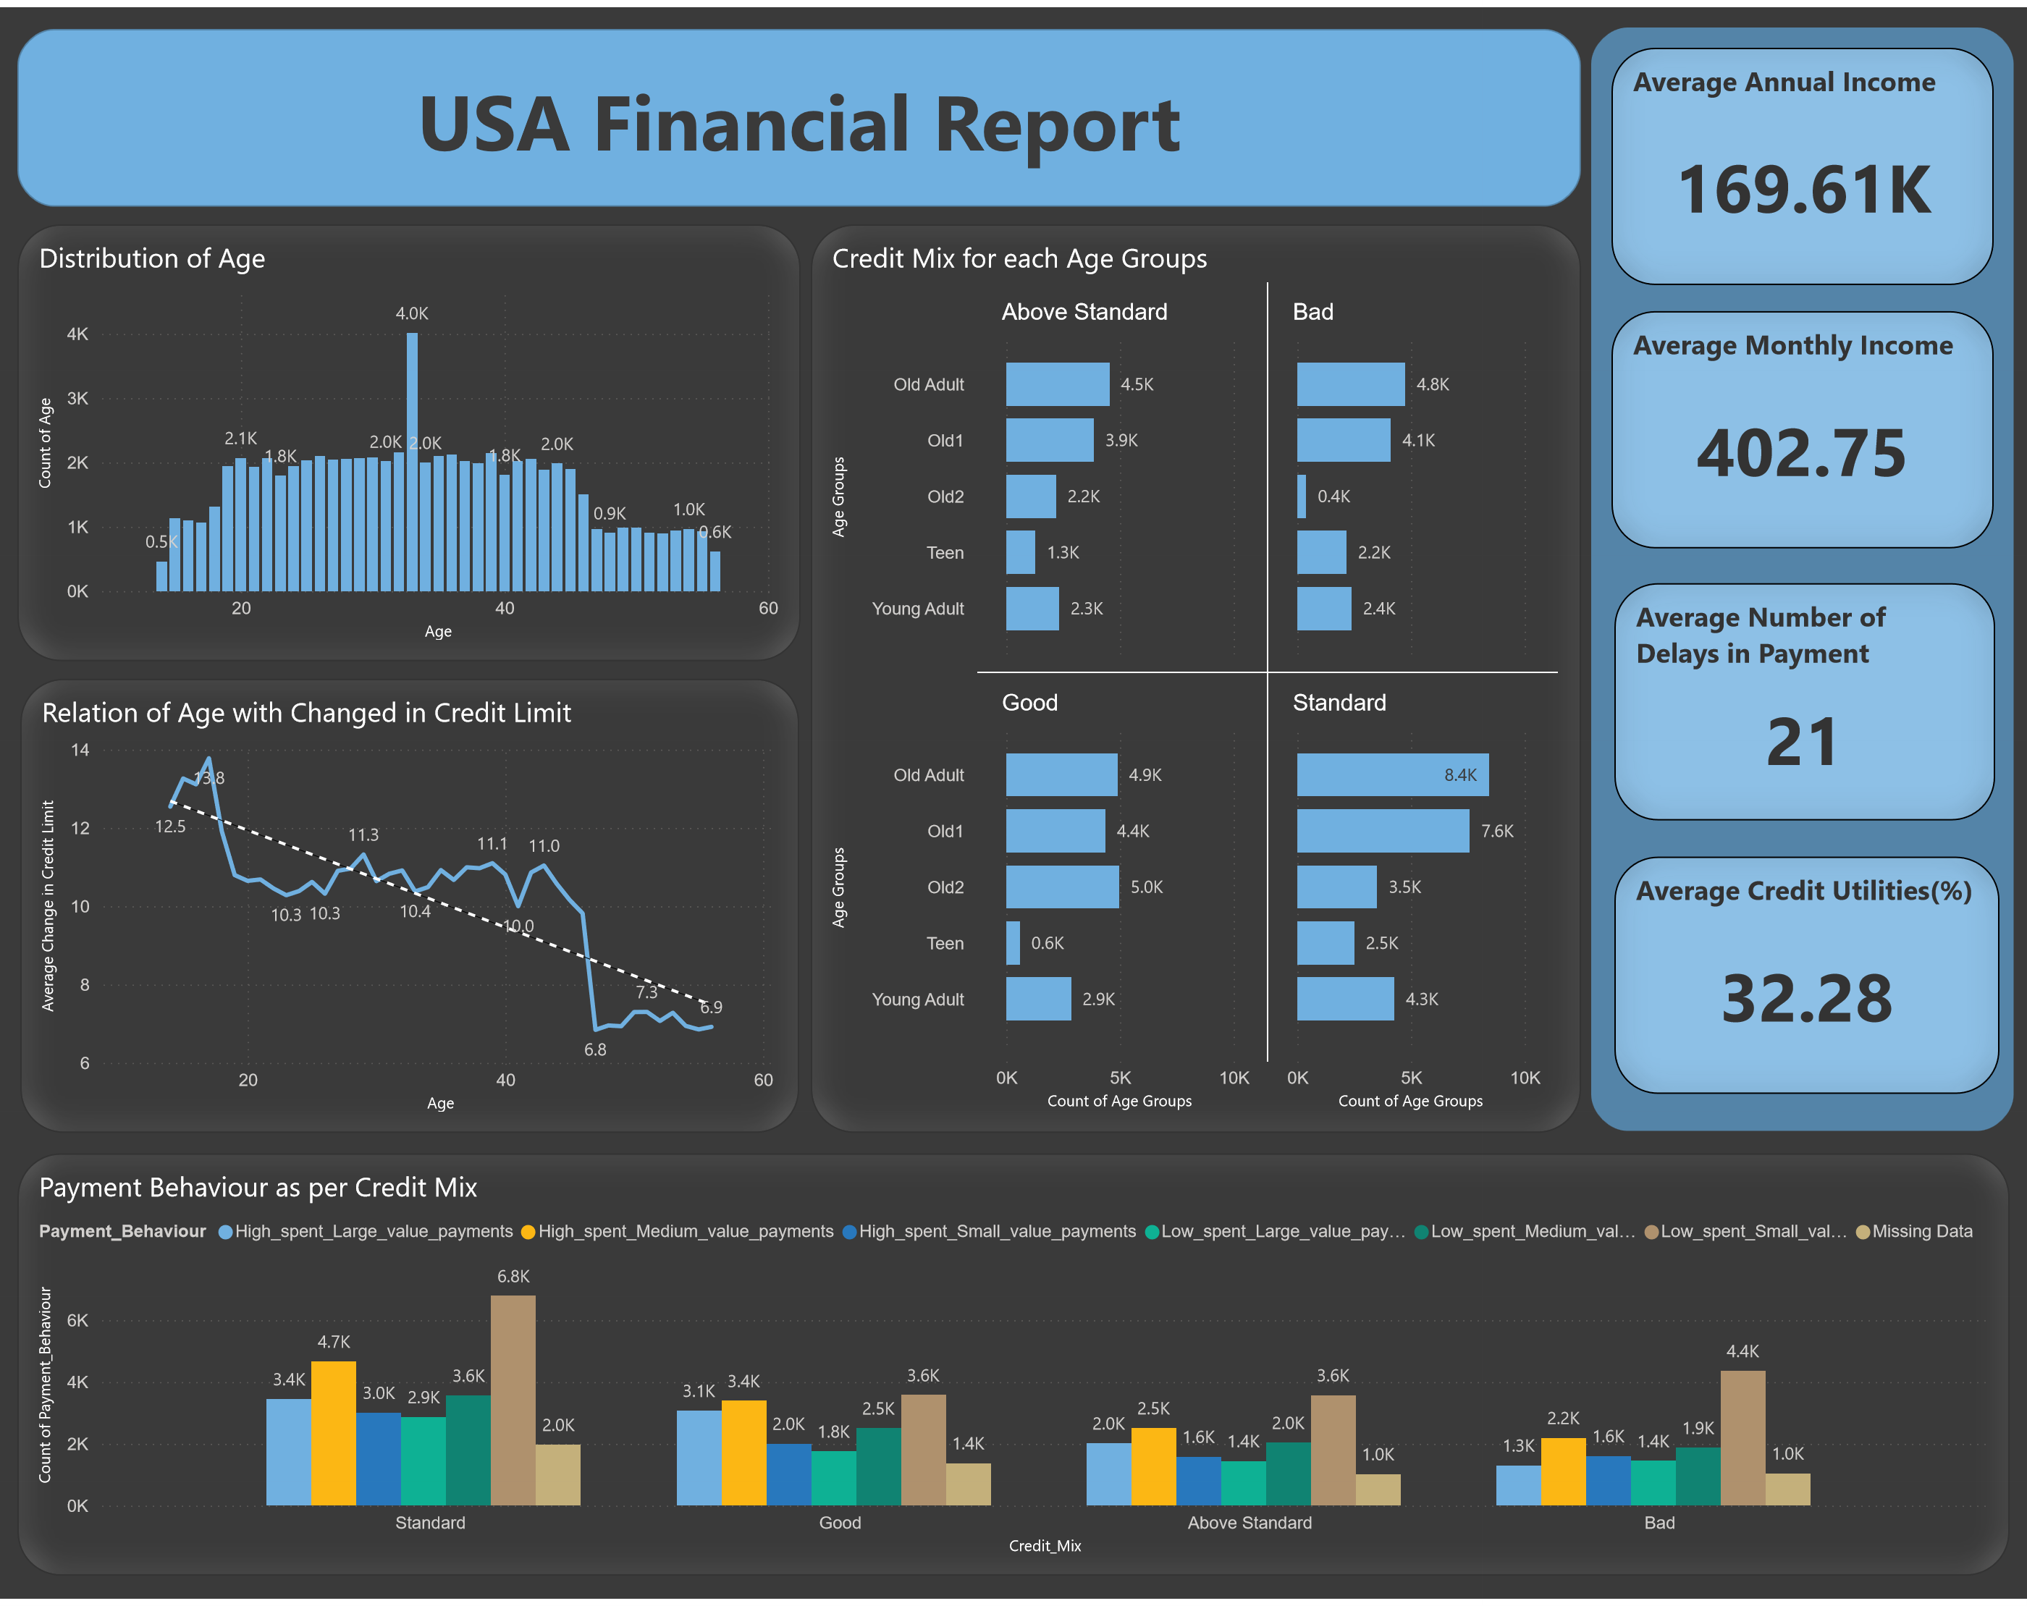
dashboard

Slide 19
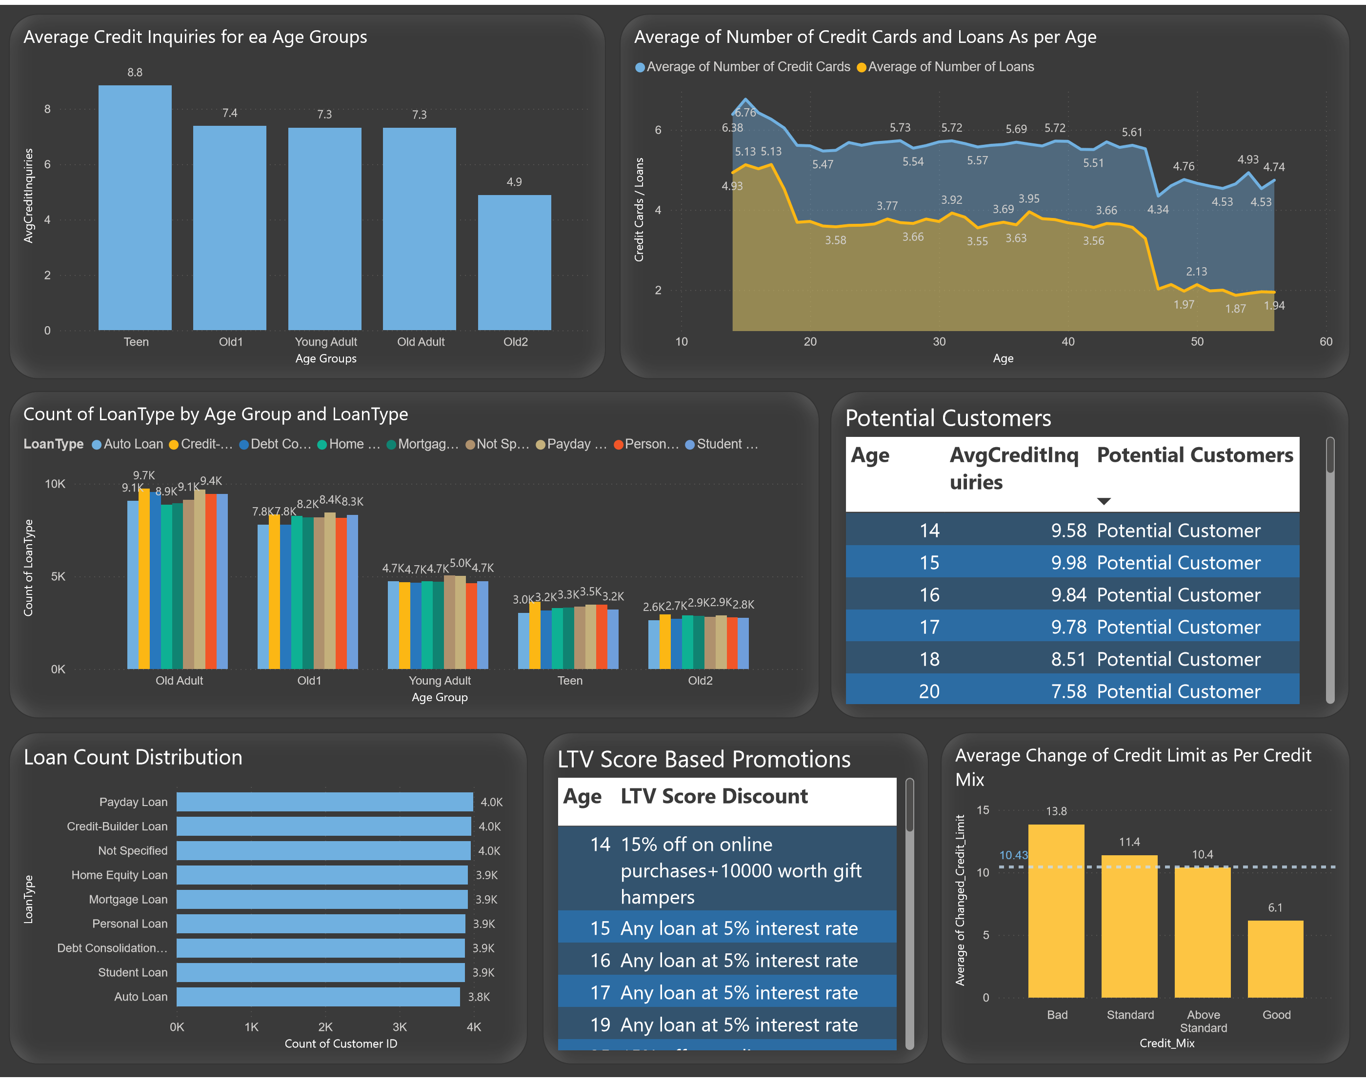

Slide 20
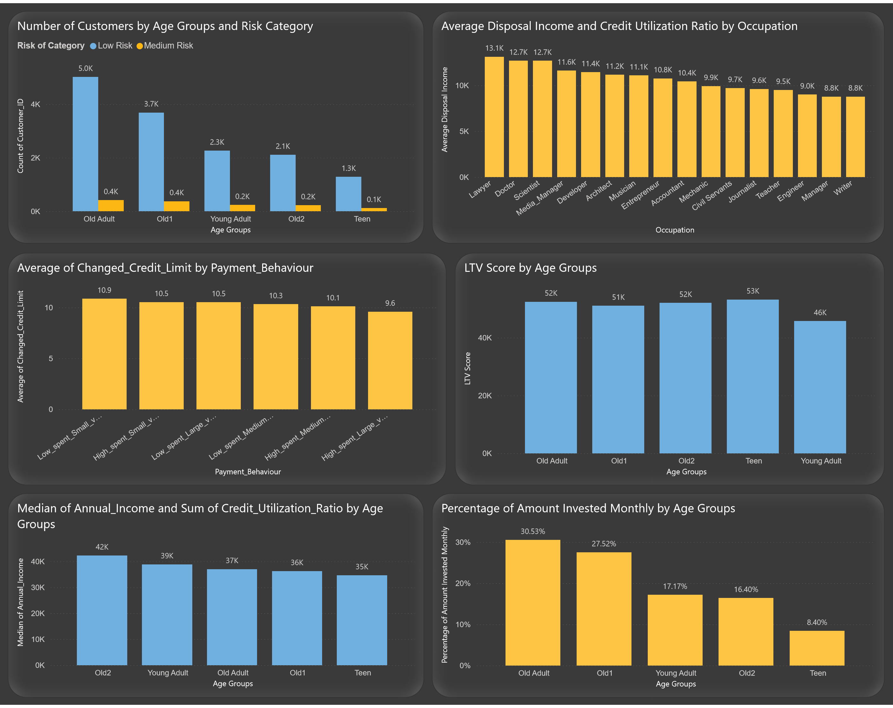

Slide 21
THANK YOU
Prayesh Godhani
prayeshgodhani04@gmail.com
https://github.com/Prayesh13

